Slide 1
Building a better AI detector using retrieval methods
Dev Bhatia
Computer Systems Lab Dr. Yilmaz
Period: 3
Date: 2/25/2025
Project Presentation 3

Slide 2
Problem
AI used very prominently
People tend to paraphrase AI content
Difficulty telling original work from AI generated text
Current AI detectors don’t work well
Leads to lack of knowledge for students
AI gives untrustworthy or false information
Need better detection mechanism

Slide 3
Background
Many AI detectors out there
Accuracy varies significantly
Unreliable for teacher use
Possibility of false positives
Not close to 100% accuracy

Slide 4
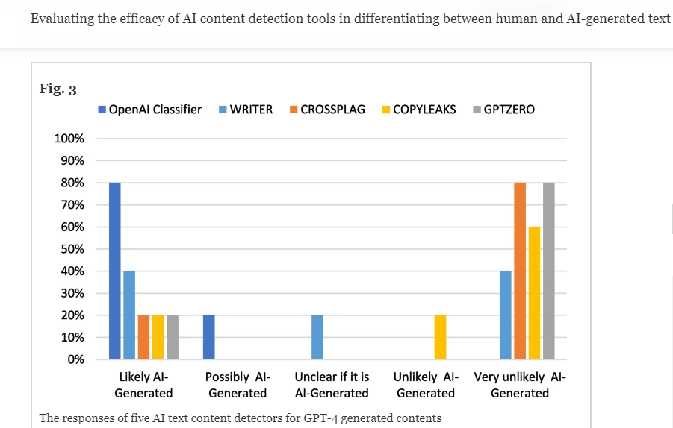
Other Solutions
Most prominent AI detectors:
GPTZero [6]
Copyleaks [7]
CrossPlag [8]
Detectors do not perform well against GPT 4.0 and other AIs
Many false negatives and uncertain classifications

Slide 5
Other Solutions Continued
How these AI detectors work
GPTZero:
Amount of predictability in the text
Looks at the variance in the sentences, AI generated text typically has less variety
Copyleaks
Scans the document against different sources to see if it matches anything
Sentence by sentence detection against human writing
CrossPlag
Text analysis using Natural Language Processing
Using a dataset created by human and AI content
Pros: Detect well on older GPT generations
Cons: Fail on GPT 4.0 and paraphrased AI generations, inconsistencies

Slide 6
Demo of current solutions
GPTZero:
CopyLeaks: (doesn't seem to work without subscription)
CrossPlag:
Sample AI generated text: “Playing basketball is always exciting. The moment I step onto the court, I feel the energy rise. The sound of the ball bouncing and sneakers squeaking on the floor makes me focus on the game. I enjoy dribbling the ball, passing to my teammates, and shooting for the basket. Each time the ball goes in, it’s a rush of excitement. Working with the team, moving fast, and thinking on my feet keeps me engaged. Basketball is not just a sport to me, it’s a fun way to stay active and connect with others.”

Slide 7
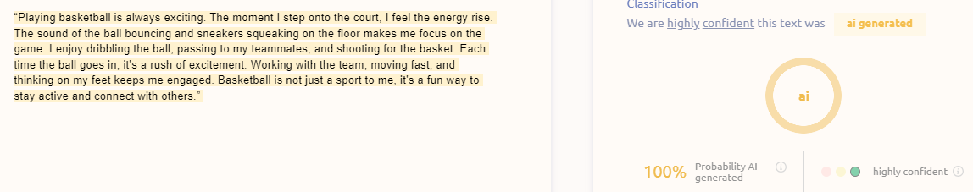
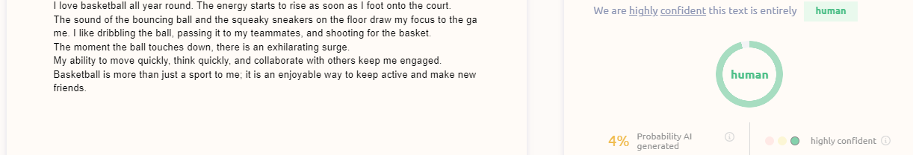
AI Detectors with paraphrasing continued

Slide 8
Why Is Mine Better?
Model that is more accurate on GPT 4.0
Current detectors struggle on this
Model that is better with paraphrased GPT 4.0
GPT 4.0 content that people paraphrase but the meaning is the same
Model that gives more consistency in detecting GPT 4.0 content
Model that works better with DeepSeek, Gemini, o3, Grok

Slide 9
Novelty
Using retrieval methods (not used on common AI detectors)
Using a database of AI generations to tell whether text is a paraphrasing of AI generated text
Use cosine similarity scores
Find any matches to previous generations
Accuracy will remain high even as the amount of paraphrasing goes up
Use on “mixing attacks”
Texts that has both human written elements and AI generated text
Higher accuracy than current AI detecting algorithms have

Slide 10
Impact
Used in school by teachers
A more reliable way to check AI content
Trustworthy source of AI detection
Maintains integrity
Creates a fair learning environment

Slide 11
Method
Store Doc2Vec encoded sequences of text that were generated by AI in database in a web server
Feed in input text
Use a Doc2Vec encoder to encode input text
Check to see if input text matches database text (cosine similarity)
Set the threshold (T), if the text score is higher than T, then it is judged as AI Generated
Output whether the text is detected as AI generated or not

Slide 12
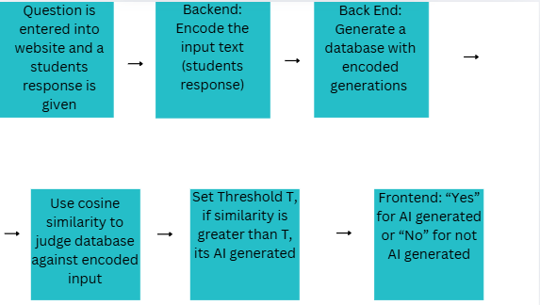
Method: System Architecture

Slide 13
Process Overview
Example:
Question (Entered by teacher): Describe the sky
Input Text (Sample response): "The sky is clear and blue"
Database of generations:
“The weather is sunny and bright” Vector: [0.45,0.25,0.65,0.1,0.35,0.3]
“Today is a clear blue day” Vector: [0.4,0.2,0.6,0.1,0.3,0.2]
“The sky is bright and blue” Vector: [0.51,0.31,0.69,0.12,0.41,0.22]
Input Text Vector Representation: [0.5,0.3,0.7,0.1,0.4,0.2]
Cosine Similarity "The sky is clear and blue" and "The sky is bright and blue" = 0.999
Threshold = 0.95
0.999 > 0.95, therefore AI generated

Slide 14
Process Overview

Slide 15
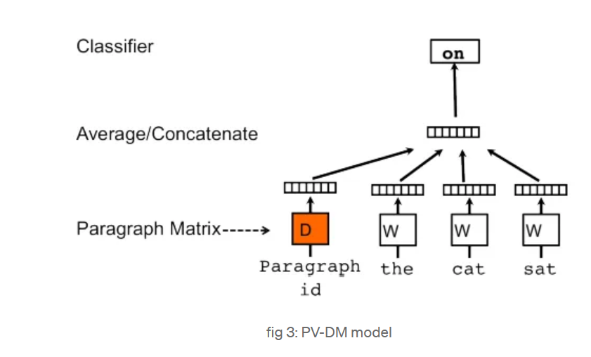
Encoding - Doc2Vec
Generates a vector representation of a document
Purpose: Captures the context of the overall document. Similar documents have similar vectors.
Uses a 2-layer neural network.

Slide 16
Doc2Vec Continued
Distributed Memory version of Paragraph Vector (PV-DM)
Input Layer: context words and a document ID
Originally the words and Doc ID is a unique vector (initialized randomly)
Hidden Layer: Combined Input (average). Activation Function (ReLU)
Use softmax function to calculate probability of each word
Output Layer: Target word
Keep updating the vectors until it gets toward desired result (minimize the loss until you get closer to the target probability distribution)
Sliding window of words (a sentence) moves around the document, and the context words and the Document ID are used to predict the target word

Slide 17
Database
Created using generations around a prompt or topic
Teacher can put a prompt in and generate AI responses
Can generate hundreds of pieces of text for the database
Take the LLM output and encode it as a vector
Store the vector in the database (Doc2Vec)

Slide 18
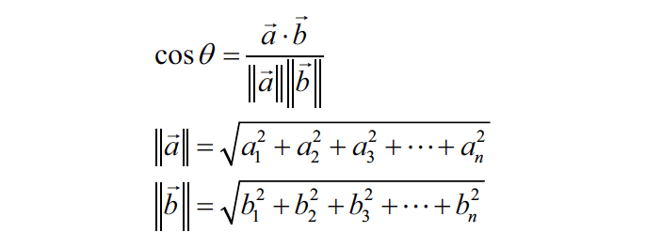
Cosine Similarity
Gives a value in the range 0 to 1
Close to 1 means the generations are similar
Close to 0 means the generations are not similar
Example:
Document 1: [1, 1, 1, 1, 1, 0] let’s refer to this as A
Document 2: [1, 1, 1, 1, 0, 1] let’s refer to this as B
Cosine Similarity = (4) / (2.2360679775*2.2360679775) = 0.80 (80 percent similarity between the two sentences)

Slide 19
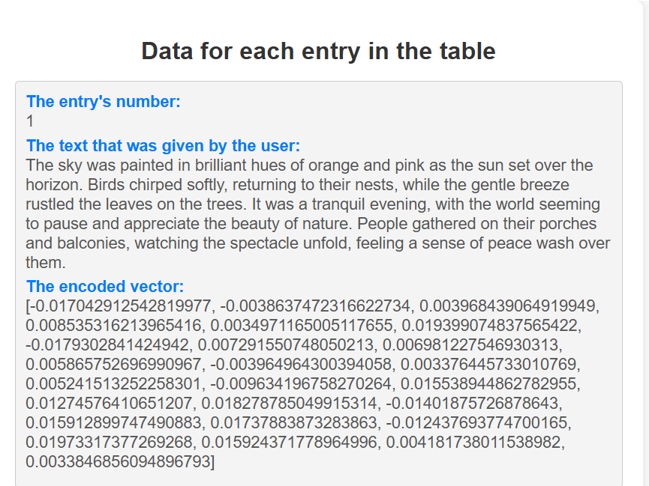
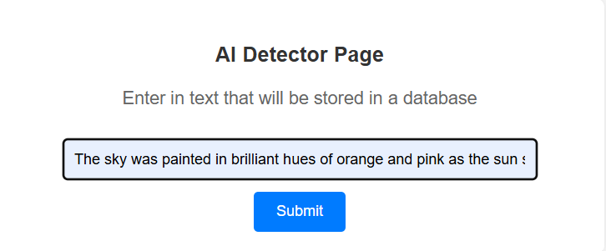
Demo

Slide 20
Results
I hope to measure 85% accuracy or better on detecting text generated by AI
Model takes input text
Could be paraphrased
Could be mixed in with human content,
Model tells whether it was AI generated or not
Expect better performance than current AI detectors

Slide 21
Limitations
Text not generated by students
Text with shorter number of words
Not using watermarking and statistical outlier methods
Text written in other languages

Slide 22
Future Work
Improvements in text generated for other things besides school
Use retrieval method along with other methods (watermarking, statistical outlier) to improve shorter text identification
Using retrieval methods with AI generations in other languages

Slide 23
Conclusion
I solved the problem of AI Detection using Retrieval Methods

Slide 24
References
[1] A. Singh, "A Comparison Study on AI Language Detector," 2023 IEEE 13th Annual Computing and Communication Workshop and Conference (CCWC), Las Vegas, NV, USA, 2023, pp. 0489-0493, doi: 10.1109/CCWC57344.2023.10099219.
[2] D. Dukić, D. Keča and D. Stipić, "Are You Human? Detecting Bots on Twitter Using BERT," 2020 IEEE 7th International Conference on Data Science and Advanced Analytics (DSAA), Sydney, NSW, Australia, 2020, pp. 631-636, doi: 10.1109/DSAA49011.2020.00089.
[3] Elkhatat, A.M., Elsaid, K. & Almeer, S. Evaluating the efficacy of AI content detection tools in differentiating between human and AI-generated text. Int J Educ Integr 19, 17 (2023). https://doi.org/10.1007/s40979-023-00140-5
[4] Krishna, Kalpesh, et al. "Paraphrasing evades detectors of ai-generated text, but retrieval is an effective defense." Advances in Neural Information Processing Systems 36 (2024).
[5] Perkins, Mike, et al. "Simple Techniques to Bypass GenAI Text Detectors: Implications for Inclusive Education: Revista De Universidad y Sociedad Del Conocimiento." International Journal of Educational Technology in Higher Education, vol. 21, no. 1, 2024, pp. 53. ProQuest, https://www.proquest.com/scholarly-journals/simple-techniques-bypass-genai-text-detectors/docview/3101842024/se-2, doi:https://doi.org/10.1186/s41239-024-00487-w.
[6]E. Tian, “GPTZero,” gptzero.me, 2022. https://gptzero.me/
[7] “Copyleaks: AI & Machine Learning Powered Plagiarism Checker,” copyleaks.com. https://copyleaks.com/ (accessed Jan. 23, 2025).
[8]“Crossplag,” app.crossplag.com. https://app.crossplag.com/individual/detector (accessed Jan. 23, 2025).

Slide 25
Q&A

Slide 26
THANKS!

